Slide 1

SimpleTest for PHP (Unit Testing
Truc Huynh & Mohammed Alswairki

Slide 2

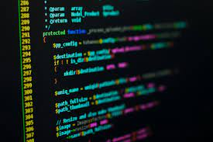


Agenda
Introduction
Overview about PHP
Tools Features
SimpleTest Pre-requirement
Steps to install SimpleTest
Why SimpleTest is Useful to Developer
SimpleTest client and Server side
Unit Test cases
Mocks and Grouping Tests
Pros vs Cons

Slide 3



Introduction
SimpleTest is regression testing framework that built around test cases as well as it is a PHP testing framework that could be used unit testing. It is used for the unit as well as Website testing framework and mock objects for PHP. It supports proxies, SSI, forms, frames etc. If you are using JUnit then you will find easier to use it. It is the part of Drupal core. It aims to be a complete PHP developer test solution (unit test, automation test, GUI test, mock object). (1)(5)

Slide 4


Overview about PHP
What is PHP
PHP is an acronym for "PHP: Hypertext Pre-processor"
PHP is a widely-used, open-source scripting language
PHP scripts are executed on the server
PHP is free to download and use.(5)
What is PHP files
PHP files can contain text, HTML, CSS, JavaScript, and PHP code
PHP code is executed on the server, and the result is returned to the browser as plain HTML
PHP files have extension ".php“. (5)

Slide 5



Tools Features
Used for unit testing
Supports simplest HTML display
Test cases are autoloading
Handles cookies when fetching various pages.
Test cases are displayed, without a web browser.
Supports Proxy, SSI, forms, frames.(5)
Easy to use and extend.(1)
Automation Testing (Schedule scripts).(1)
Can Navigate websites, fill in form, authentication, web tester.(1)

Slide 6


SimpleTest Pre-requirement
Understanding of testing methods(in this case Unit Testing).
Understanding of PHP web development language.
Knowing how to program (design for developer and tester).

Slide 7
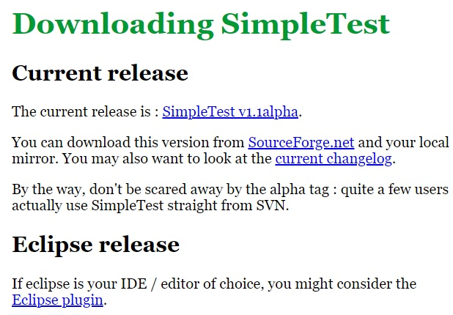
Steps to install
Step 1: Setting up the SimpleTest framework requires the latest version of PHP to be installed in the system.
Step 2: Once it is done you may setup the framework by downloading SimpleTest and Eclipse Plugin from their official website.

Slide 8


What makes this tool immediately useful to the PHP developer?
SimpleTest is Built in web browser (no need for selenium). This allows tests that navigate web sites, fill in forms and test pages. Being able to write these tests in PHP means that it is easy to write integrated tests.
SimpleTest is a testing framework built around test case classes. These are written as extensions of base test case classes, each extended with methods that contain test code. Each test method of a test case class is written to invoke various assertions that the developer expects to be true such as assertEqual(). If the expectation is correct, then a successful result is dispatched to the observing test reporter, but any failure or unexpected exception triggers an alert and a description of the mismatch. These test case declarations are transformed into executable test scripts by including a SimpleTest aurorun.php file.(1)()

Slide 9
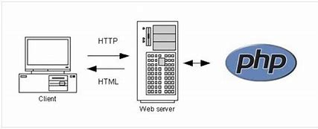
SimpleTest: Testing Client and Server Side
Client Side: SimpleTest Allows testing code execution on the client, such as a web browser which is focusing on PHP tasks, such as logging into a site
Server side: Server-side behavior can be tested by writing simple unit tests to test functionality and behavior of single components.(7)

Slide 10


Unit Test Cases
The simplest type of all test case is the unit test
implement SimpleTest framework by extend the UnitTestCase.
This class of test case includes standard tests for equality, references and pattern matching

Slide 11
UnitTestCase Class
Some function of UnitTestCase class, the default for SimpleTest
assertTrue($x) // Fail if $x is false
assertFalse($x) // Fail if $x is true
assertNull($x) // Fail if $x is set
assertNotNull($x) // Fail if $x not set
assertIsA($x, $t) // Fail if $x is not the class or type $t
assertNotA($x, $t) // Fail if $x is of the class or type $t
assertEqual($x, $y) // Fail if $x == $y is false
assertNotEqual($x, $y) // Fail if $x == $y is true
assertWithinMargin($x, $y, $m) // Fail if abs($x - $y) < $m is false
assertOutsideMargin($x, $y, $m) // Fail if abs($x - $y) < $m is true
// see more at http://simpletest.sourceforge.net/en/unit_test_documentation.html

Slide 12
Using The tester quickly
Let's start by creating a test script to test a simple file logging class called log in classes/log.php.
The simpletest folder is located in the path to the program and the local or local version of the file is used as the path. The "autorun.php" file is used to run the test.
The first test case that we created is the TestOfLogging. It's a class that takes advantage of the SimpleTet base classes.
Now we have a test suite but no tests though
We will assume that the log class takes the file name to write to in the constructor and we have temporary folder in which to place this file

Slide 13
Using The tester quickly (cont.)
During running test case tester will search for any method starts with string “test” and execute the method if the method starts “ test”.
testLogCreatesNewFileOnFirstMessage(). This is considered good style and makes the test output more readable.
Assertions within the test methods trigger messages to the test framework which display the result immediately. This immediate response is important, not just in the event of the code causing a crash, but also so that print statements can display their debugging content right next to the assertion concerned

Slide 14
Using The tester quickly (cont.)
To see the result we have run the test, no other code is required just we have to open the page on browser
On failure the display looks like this
if it passes like this.
if you get this, it means we are missing The classes/Log.php
file the could look like

Slide 15
Convenience Methods (UnitTestCase Class)
The test cases also have some convenience methods for debugging code or extending the suite
setUp() // Runs this before each test method
tearDown() // Runs this after each test method
pass() // Sends a test pass
fail() // Sends a test failure
error() // Sends an exception event
signal($type, $payload) // Sends a user defined message to the test reporter
dump($var) // Does a formatted print_r() for quick and dirty debugging

Slide 16
Simple Use Case (Unit Test)
<?php
// The "autorun.php" file does more than just include the SimpleTest files, it also runs our test for us
require_once('simpletest/autorun.php');
require_once('../classes/writer.php');
// use extends UnitTestCase to implement simple test
class FileTestCase extends UnitTestCase {
function FileTestCase() {
$this->UnitTestCase('File test');} // Constructor
//run just before each and every test method
function setUp() {
@unlink('../temp/test.txt');}
//run just before each and every test method
function tearDown() {
@unlink('../temp/test.txt');}
// When a test case runs, it will search for any method that starts with the string "test" and execute that method.
function testCreation() {
$writer = &new FileWriter('../temp/test.txt');
$writer->write('Hello');
// using assertTrue function validate if the test.txt is exit, if true print 'File created'
$this->assertTrue(file_exists('../temp/test.txt'), 'File created');
}}?>
Simple test case that check a file has been created by the Writer object

Slide 17
Mocks and Grouping Tests
Mocks are objects that simulate the behavior of real objects. Using mocks allows testing some part of the code in isolation (with other parts mocked when needed).SimpleTest allows for one to build Mock objects.To create a mock version of a class we need to include the mock object library and run the generator. This will create a clone class which we use to create new instances(objects) in our test cases (2)(7)
Grouping Allows organizing tests in groups , here are several ways of grouping tests; one is to simply place multiple test cases into a single file, another is to mark any base test cases that should not be run as abstract, SimpleTest gives you a couple of options(7)

Slide 18
User Case 1 (Mock Objects)
Precondition:
We test a web app
Our app make HTTP requests to an external services
External services always perform as expected but what if the services fail?
Temporary change in the behavior of these external services can cause immediate failures within our test suite.
Benefit of using Mock Objects:
We test our app in a controlled environment
Replacing actual request with a mock object (simulated object)
Successfully simulate external services outage and design a response (in a predicted way)

Slide 19
Use Case 2 (Mock Objects)
<?php
// database_connection.php
class DatabaseConnection {
function DatabaseConnection() { // do some}
function query() { // do some query}
function selectQuery() { // do some searches}
}
?>
Technology
PHP
SimpleTest
Scenario:
Test database connection, simulate database being down without creating new real broken database(s)
Step
Create DatabaseConnection class store in script 'database_connection.php':

Slide 20
Use Case 2 (Mock Objects) (cont.)
<?php
require_once('simpletest/unit_tester.php');
require_once('simpletest/mock_objects.php'); //include the mock object library
require_once('database_connection.php');
Mock::generate('DatabaseConnection'); // run the generator to create a mock version of DatabaseConnection
?>
Run the generator to create mock version of DatabaseConnection
This generates a clone class called MockDatabaseConnection.
We can now create instances of the new class within our test case
<?php
class MyTestCase extends UnitTestCase {
function testSomething() {
$connection = &new MockDatabaseConnection();
}
}
?>

Slide 21
Group Test
<?php
// when list as abstract MyFileTestCase will not execute
abstract class MyFileTestCase extends UnitTestCase {
//Do sometest
}
class FileTester extends MyFileTestCase {
//Do sometest
}
class SocketTester extends UnitTestCase {
//Do sometest
}
?>
Group test cased to create test suites.
Template of test suite, Log_test.php content

Slide 22
Group Test (cont.)
<?php
require_once('simpletest/autorun.php');
// Note that allTest extends TestSuite
class AllTests extends TestSuite {
function AllTests() {
$this->TestSuite('All tests');
$this->addFile('log_test.php');
}
}
?>
Script 2: Test suite ‘all-test.php’

Slide 23
Pros vs Cons
Pros:
SimpleTest is very useful for unit testing
SimpleTest tests every part.
Easy to understand and find bugs if unit testing is done.
Execution will be fast.
It provides an extensive support for forms, SSL, frames, proxies, and basic authentication.
It has an inbuilt web browser, which helps in testing web applications.
Tests can be executed through the browser as well as the command line.
SimpleTest is highly flexible as it allows result or output customization
It is an open-source tool and its available at no cost in the market.
Cons:
Mocking is complicated.
Can’t say that every part of the system will work correctly.(5,6,7)

Slide 24
References
Simple Test for PHP (1)
mock object (2)
Understanding the Python Mock Object Library (3)
PHP Introduction (4)
Top 10 Popular PHP Testing Frameworks and Tools (softwaretestinghelp.com)(5)
10 Of The Best PHP Testing Frameworks For 2021 (lambdatest.com)(6)
SimpleTest vs PHPUnit comparison of testing frameworks (knapsackpro.com) (7)

Slide 25

Thank you

